Slide 1
Information Visualization Checkpoint I: Project Proposal
G16
89425 – Daniel Pereira
89466 – Isabel Soares
89535 – Rodrigo Sousa
Notes:
(Sousa)

Slide 2
DOMAIN
01
Notes:
(Isabel)

Slide 3
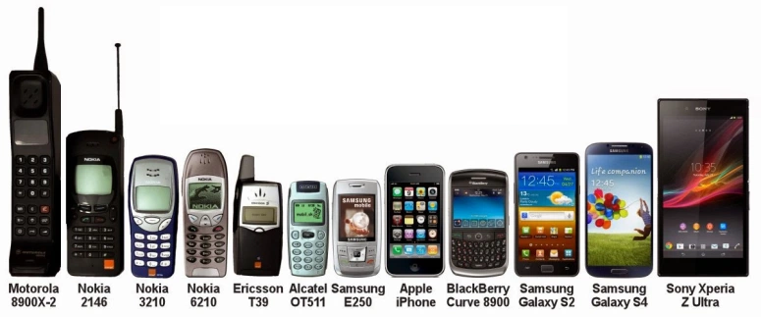
Domain
High level description
“The Evolution of Mobile Phones: Brands and Specs”
Notes:
(Isabel)
In this project we are looking into “The Evolution of Mobile Phones: Brands and Specs”. With this visualization, we hope to show how the brands and models developed over time both economically and in terms of the technology and its hardware. We think this is an interesting subject to explore because we are a technological generation and through this project we will be able to expose the evolution of a device so crucial to our lives.

Slide 4
DATASET
02
Notes:
(Daniel)

Slide 5

Dataset
Dataset description
The first dataset is available in Back4App and can be freely downloaded for further use and can be accessed either by the raw file or by their API.
Notes:
(Daniel)
We came across two different datasets that will complement each other to enhance the visualization:
The datasets we’ll be using are “Cell Phones Brands and Models” and “List of best-selling mobile phones - Annual sales by manufacturer”.
The first dataset is available in Back4App and can be freely downloaded for further use and can be accessed either by the raw file or by their API.
https://www.back4app.com/database/paul-datasets/cell-phone-dataset

Slide 6

Dataset
Dataset description
The second dataset will need to be treated because the information is stored on a table of a Wikipedia Web Page.
Notes:
(Sousa)
The second dataset will need to be treated because the information is stored on a table of a Wikipedia Web Page. Furthermore, the last dataset will complement the first dataset, which doesn't contain the brands sales.
https://en.wikipedia.org/wiki/List_of_best-selling_mobile_phones#Annual_sales_by_manufacturer

Slide 7
Example QUESTIONS
03
Notes:
(Sousa)

Slide 8
Questions
What’s the average battery life for all phones grouped by brand?
What cell phone brands had a peak in sales? When?
What’s the cell phone brand that has more models?
Notes:
(Isabel)

Slide 9
Questions
What phone brand has released the most phone models in a given year?
Is there a correlation between the number of models of a brand and that brand’s revenue?
What are the hardware specifications of each model?
Notes:
(Daniel)

Slide 10
Questions
By selecting a specific model which are the phones that are more similar to this one in terms of its specifications?
When did a certain specification / hardware component start to be implemented on phones? What was its prevalence in phone models across the years?
Notes:
(Sousa)

Slide 11
Data Sample
04
Notes:
(Sousa)

Slide 12
Data Sample
(from “Dataset_Cell_Phones_Model_Brand.json”)
Brand; Model; Network; (…); Sensors; Battery; Colors;

Slide 13
Data Sample
{
"Model": "_3",
"Brand": "Nokia",
"Network": "GSM / HSPA / LTE",
(...)
"Sensors": "Accelerometer| gyro| proximity| compass",
"Battery": "Non-removable Li-Ion 2630 mAh battery",
"Colors": "Silver White| Matte Black| Tempered Blue| Copper White"
}

Slide 14
Data Sample
(from “List of best-selling mobile phones - Annual sales by manufacturer”)
Manufacturer; 1992; 1993; 1994; (…)
Nokia; 3; 5; 9; (…)

